Slide 1
SS ZG653: Software Architecture Lecture 7: Introduction to UML
Instructor: Prof. Santonu Sarkar
Feb 4, 2015

Slide 2
Unified Modeling Language (Introduction)
Modeling Language for specifying, Constructing, Visualizing and documenting software system and its components
Model -> Abstract Representation of the system [Simplified Representation of Reality]
UML supports two types of models:
- Static - Dynamic

Slide 3
UML
Unified Modeling Language is a standardized general purpose modeling language in the field of object oriented software engineering
The standard is managed, and was created by, the Object Management Group.
UML includes a set of graphic notation techniques to create visual models of object-oriented software-intensive systems

Slide 4
UML Diagrams overview
Structure diagrams emphasize the things that must be present in the system being modeled- extensively used for documenting software architecture
Behavior diagrams illustrate the behavior of a system, they are used extensively to describe the functionality of software systems.
Diagram
Structure Diagram
Behavior Diagram
Activity Diagram
Activity Diagram
Use Case Diagram
State Machine Diagram
Class Diagram
Component Diagram
Object Diagram
Use Case Diagram
Profile Diagram
Composite Structure Diagram
Deployment Diagram
Interaction Diagram
Package Diagram
Sequence Diagram
Timing Diagram
Sequence Diagram
Communication Diagram
Interaction Diagram
Notes:
Structure diagrams
Structure diagrams emphasize the things that must be present in the system being modeled. Since structure diagrams represent the structure, they are used extensively in documenting the software architecture of software systems.
Class diagram: describes the structure of a system by showing the system's classes, their attributes, and the relationships among the classes.
Component diagram: describes how a software system is split up into components and shows the dependencies among these components.
Composite structure diagram: describes the internal structure of a class and the collaborations that this structure makes possible.
Deployment diagram: describes the hardware used in system implementations and the execution environments and artifacts deployed on the hardware.
Object diagram: shows a complete or partial view of the structure of an example modeled system at a specific time.
Package diagram: describes how a system is split up into logical groupings by showing the dependencies among these groupings.
Profile diagram: operates at the metamodel level to show stereotypes as classes with the <<stereotype>> stereotype, and profiles as packages with the <<profile>> stereotype. The extension relation (solid line with closed, filled arrowhead) indicates what metamodel element a given stereotype is extending.
Behaviour diagrams
Behaviour diagrams emphasize what must happen in the system being modelled. Since behaviour diagrams illustrate the behavior of a system, they are used extensively to describe the functionality of software systems.
Activity diagram: describes the business and operational step-by-step workflows of components in a system. An activity diagram shows the overall flow of control.
UML state machine diagram: describes the states and state transitions of the system.
Use case diagram: describes the functionality provided by a system in terms of actors, their goals represented as use cases, and any dependencies among those use cases.
Interaction diagrams
Interaction diagrams, a subset of behaviour diagrams, emphasize the flow of control and data among the things in the system being modeled:
Communication diagram: shows the interactions between objects or parts in terms of sequenced messages. They represent a combination of information taken from Class, Sequence, and Use Case Diagrams describing both the static structure and dynamic behavior of a system.
Interaction overview diagram: provides an overview in which the nodes represent communication diagrams.
Sequence diagram: shows how objects communicate with each other in terms of a sequence of messages. Also indicates the lifespans of objects relative to those messages.
Timing diagrams: a specific type of interaction diagram where the focus is on timing constraints.

Slide 5
Structural Diagrams
Class diagram: system's classes, their attributes, and the relationships
Component diagram: A system, comprising of components and their dependencies
Composite structure diagram: decomposition of a class into more finer elements and their interactions
Deployment diagram: describes the hardware used in system implementations and the execution environments and artifacts deployed on the hardware.
Object diagram: shows a complete or partial view of the structure of an example modeled system at a specific time.
Package diagram: describes how a system is split up into logical groupings by showing the dependencies among these groupings.
Profile diagram: operates at the metamodel level

Slide 6
Behavioral Diagrams
Activity diagram: describes the business and operational step-by-step workflows of components in a system. An activity diagram shows the overall flow of control.
State machine diagram: describes the states and state transitions of part of the system.
Use case diagram: describes the functionality provided by a system in terms of actors, their goals represented as use cases, and any dependencies among those use cases

Slide 7
Behavioral Model- Interactions
Communication diagram: shows the interactions between objects or parts in terms of sequenced messages. They represent a combination of information taken from Class, Sequence, and Use Case Diagrams describing both the static structure and dynamic behavior of a system.
Interaction overview diagram: provides an overview in which the nodes represent communication diagrams.
Sequence diagram: Interaction among objects through a sequence of messages. Also indicates the lifespans of objects relative to those messages
Timing diagrams: a specific type of sequence diagram where the focus is on timing constraints.

Slide 8
Petstore Shopping System
Vendors, Suppliers, Delivery
Customers
Monitoring Component
Analysis Component
Business partners such as e-marketplace sellers
Petstore online shopping system
Main Processing
IT providers
Financial service providers

Slide 9
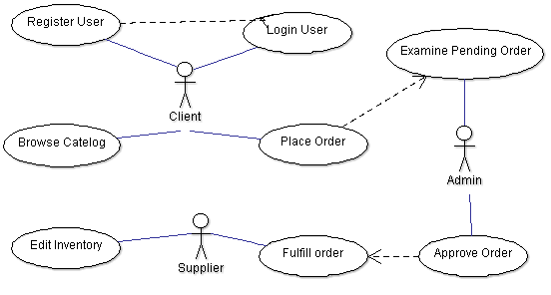
Use Case
Storefront has the main user interface in a Web front-end. Customers use the Storefront to place orders for pets
Register User
Login user
Browse catalog of products
Place order to OPC (asynchronous messaging)
Order Processing Center (OPC) receives orders from the Storefront.
Administrator
Examine pending orders
Approve or deny a pending order
Supplier
View and edit the inventory
Fulfills orders from the OPC from inventory and invoices the OPC.

Slide 10
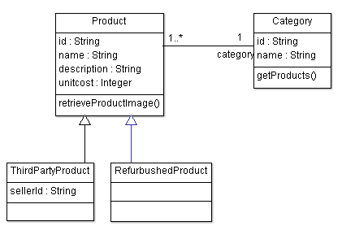
Class Notation
class name
operations
attributes
Visibility Modes : Private( - ), Protected (#) , Public (+) and Package Private()

Slide 11
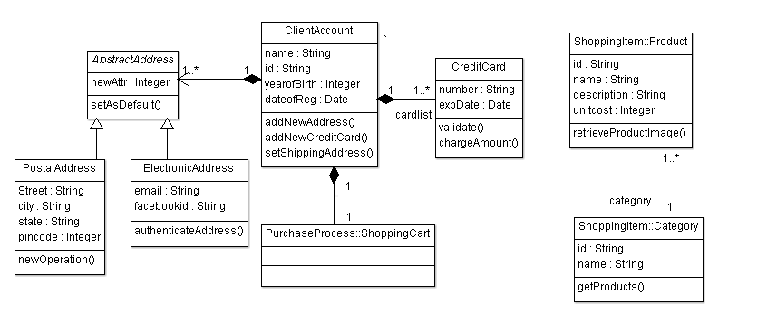
Class Relationships
Inheritance
Composition
Association

Slide 12
Generalization Example
isA, is-a-type of relation ship
A PostalAddress, or an EmailAddress is an Address
There can be ThirdPartyProduct or a Refurbished product in the online store
public class ElectronicAddress extends AbstractAddress {
private String email;
private String facebookid;
public void authenticateAddress() {
}
}
public class PostalAddress extends AbstractAddress {
private String Street;
private String city;
private String state;
private Integer pincode;
}

Slide 13
Different forms of association
Strongest (Composition)
Implies total ownership, if the owner is destroyed, the parts are also destroyed
Inner classes will certainly be a composition
Aggregation
Implies has-a part ownership
If the owner is destroyed, the parts still exist
Weakest (Association)
General form of dependency based on the usage of features

Slide 14
Composition
Total ownership
A CreditCard exclusively belongs to one Client, and one client can have many credit cards.
A client exclusively owns her shopping cart.
The shopping cart and the credit card will no longer exist if the client is removed
ClientAccount
1
1..*
CreditCard
1
1
ShoppingCart

Slide 15
Composition Code snippet
public class CreditCard {
private String number;
private Date expDate;
private ClientAccount
myClientAccount;
public void validate() { }
public void chargeAmount() { }
}
public class ClientAccount {
private String name;
private String id;
private Integer yearofBirth;
private Date dateofReg;
private Vector myAbstractAddress;
private Vector myCreditCard;
private ShoppingCart myShoppingCart;
public void addNewAddress() { }
public void addNewCreditCard() { }
public void setShippingAddress() { }
}
public class ShoppingCart {
private Vector myShoppingCartController;
private ClientAccount myClientAccount;
}

Slide 16
Aggregation Relationship
Relatively weaker composition
Students will exist even when the Professor stops taking the class
Ducks will exist without the Pond
1
Professor
1..1000
Students
teaches
Pond
1
0..*
Duck
has

Slide 17
Association or Dependency Relation
A product category in the online shop can have many products
However, a product belongs to only one category.
Both of them independently exist.
Product
0..*
1
Category
category
public class Product {
private String id;
private String name;
private String description;
private Integer unitcost;
private Category category;
public void retrieveProductImage() {
}
}
public class Category {
private String id;
private String name;
private Vector<Product> myProduct;
public void getProducts() {
}
}

Slide 18
Dependency Example 2
class B
{
public void doB()
{
System.out.println(“Hello”);
}
}
class A
{
public void doS()
{
B b1 = new B();
b1.doB();
}
} //End of class Test
A
B
calls

Slide 19
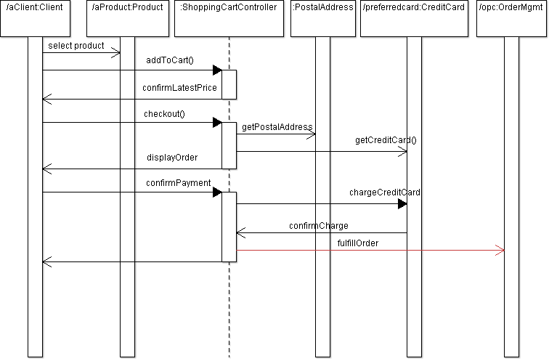
Sequence Diagrams
Sequence diagram is drawn to represent (i) objects participating in an interaction and (ii) what messages have exchanged among those objects

Slide 20
Introducing Agile methods

Slide 21
What is Agile Methodology
Collaborative
Forms a pair for any development task to avoid error
Involves stakeholders from the beginning
Interactive and feedback oriented
Teams interact frequently
Quick, and repeated integration of the product
Constant feedback from the stakeholder (customer)
Iterative
Requirement, design, coding, testing goes through many iterations each having short duration
Refactoring is a part of the development process
Test driven
Before building the component, define the test cases
Continuously test
Scott Amber, Kent Beck

Slide 22
Class Responsibilities and Collaborators (CRC) Card
What
Why?
It is a physical (electronic) card
One card for one class
Indicates the responsibilities of a class
Collaboration
Sometimes a class can fulfill all its assigned responsibilities on its own
But sometimes, it needs to collaborate with other classes in order to fulfill its own responsibilities
A good technique to identify a class and its responsibility during functional architecture design
Highly collaborative and interactive process for a team of designers
The team can do it fast

Slide 23
CRC Card
Class Name
Collaborators
If this class can not fulfill any of its assigned task on its own then which other classes it has to collaborate
Responsibilities assigned to this Class

Slide 24
CRC Card Example 1
class Box
{
private double length;
private double width;
private double height;
Box(double l, double w, double h) { length = l; width = w; height = h; }
public double getLength() { return length; }
public double getWidth() { return width; }
public double getHeight() { return height; }
public double area() { return 2*(length*width + width * height + height * length); }
public double volume() { return length * width * height; }
} // End of class BOX
Write CRC Cards for Box Class
Box
Collaborators
<<None>>
Responsibilities
Getting length
Getting width
Getting height
Computing area and volume

Slide 25
CRC Card Example 2
class B
{
public void doB()
{
System.out.println(“Hello”);
}
}
class A
{
public void doS()
{
B b1 = new B();
b1.doB();
}
} //End of class Test
Write CRC Cards for Classes A & B
A
B

Slide 26
How do you create CRC Model?
Find Main Classes (say top 10)
Actors, Main modules
Define Responsibilities
Define Collaborators
Move cards- group them based on who collaborates with whom

Slide 27
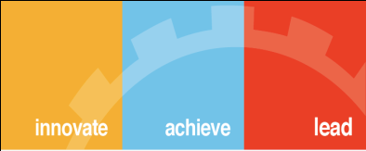
Thank You

